Slide 1
Accounting Principles, 7th Edition
Weygandt • Kieso • Kimmel
Chapter 3
Adjusting the Accounts
Prepared by Naomi Karolinski
Monroe Community College
and
Marianne Bradford
Bryant College
John Wiley & Sons, Inc. © 2005

Slide 2
CHAPTER 3 ADJUSTING THE ACCOUNTS
After studying this chapter, you should be able to:
1 Explain the time period assumption
2 Explain the accrual basis of accounting
3 Explain why adjusting entries are needed
4 Identify the major types of adjusting entries
5 Prepare adjusting entries for prepayments
6 Prepare adjusting entries for accruals
7 Describe the nature and purpose of an adjusted trial balance

Slide 3
TIME-PERIOD ASSUMPTION
STUDY OBJECTIVE 1
The time period (or periodicity) assumption
  assumes the economic life of a business can be divided into artificial time periods
Accounting time periods
  generally month, a quarter, or a year
Accounting time period of one year in length
  referred to as a fiscal year
Notes:
1

Slide 4
ACCRUAL BASIS OF ACCOUNTING
STUDY OBJECTIVE 2
Revenue recognition and matching principles
  Used under the accrual basis of accounting
Cash basis accounting
  revenue is recorded when cash is received
  expenses are recorded when cash is paid
GAAP requires accrual basis accounting
  cash basis often causes misleading financial statements.

Slide 5
REVENUE RECOGNITION PRINCIPLE
  Revenue recognition principle
    Revenue must be recognized in the accounting period in which it is earned, not just when money is exchanged.
    In a service business, revenue is earned at the time the service is performed.
Notes:
2

Slide 6
THE MATCHING PRINCIPLE
Expense recognition is the matching principle.
Efforts (expenses) must be matched with accomplishments (revenues).
Expenses
incurred in
earning the
revenue
Revenues
earned
this month
are offset
against....
Notes:
3

Slide 7
GAAP RELATIONSHIPS IN REVENUE AND EXPENSE RECOGNITION
Time-Period Assumption
Economic life of business
can be divided into
artificial time periods
Revenue-Recognition Principle
Matching Principle
Revenue recognized in
the accounting period in
which it is earned
Expenses matched with revenues
in the same period when efforts are expended to generate revenues
Notes:
Ungroup –lighten blue and grey.

Slide 8
ADJUSTING ENTRIES
STUDY OBJECTIVE 3
Adjusting entries are made in order for:
revenues to be recorded in the period in which they are earned
expenses to be recognized in the period in which they are incurred
Notes:
4

Slide 9
ADJUSTING ENTRIES
STUDY OBJECTIVE 4
Adjusting entries
  required each time financial statements are prepared
Adjusting entries are classified as
Prepayments (prepaid expenses and unearned revenues) OR
Accruals (accrued revenues and accrued expenses)
Notes:
5

Slide 10
TYPES OF ADJUSTING ENTRIES
Prepayments
Prepaid Expenses
Expenses paid in cash - recorded as assets before used or consumed
Unearned Revenues
Cash received - recorded as liabilities before the revenue is earned

Slide 11
TYPES OF ADJUSTING ENTRIES
Accruals
Accrued Revenues
revenues earned but not yet received in cash or recorded
Accrued Expenses
expenses incurred but not yet paid in cash or recorded

Slide 12
TRIAL BALANCE
PIONEER ADVERTISING AGENCY
Trial Balance
October 31, 2005
Debit
Credit
Cash
$ 15,200
Advertising Supplies
The Trial Balance is the starting place for adjusting entries.
2,500
Prepaid Insurance
600
Office Equipment
5,000
Notes Payable
$ 5,000
Accounts Payable
2,500
Unearned Revenue
1,200
C. R. Byrd, Capital
10,000
C. R. Byrd, Drawing
500
Service Revenue
10,000
Salaries Expense
4,000
Rent Expense
900
$ 28,700
$ 28,700

Slide 13
PREPAYMENTS
STUDY OBJECTIVE 5
Prepayments
The first category of adjusting entry is prepayments.
Required to record revenues earned and expenses incurred
  Also ensures that assets and liabilities are not overstated
The adjusting entry for prepayments:
  Increases an income statement account
  Decreases a balance sheet account

Slide 14
ADJUSTING ENTRIES FOR PREPAYMENTS
Adjusting Entries
Prepaid Expenses
Asset
Expense
Unadjusted Balance
Credit Adjusting Entry (-)
Debit Adjusting Entry (+)
Unearned Revenues
Liability
Revenue
Debit Adjusting Entry (-)
Unadjusted Balance
Credit Adjusting Entry (+)

Slide 15
PREPAID EXPENSES
Prepaid expenses
  expenses paid in cash and recorded as assets before they are used or consumed
  Prepaid expenses expire with the passage of time or through use and consumption
An asset-expense account relationship exists with prepaid expenses
Notes:
6

Slide 16
PREPAID EXPENSES
Prior to adjustment
  assets are overstated and expenses are understated
Adjusting entry
  debit expense account
  credit asset account
Examples
  prepaid expenses include supplies,
  insurance, and depreciation
Notes:
7

Slide 17



ADJUSTING ENTRIES FOR PREPAYMENTS SUPPLIES
ADJUSTMENT
October 31, an inventory count reveals that $1,000 of $2,500 of supplies are still on hand.
JOURNAL ENTRY
POSTING

Slide 18
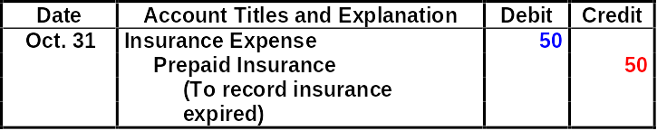

ADJUSTING ENTRIES FOR PREPAYMENTS INSURANCE
ADJUSTMENT
October 31, an analysis of the policy reveals that $50 of insurance expires each month.
JOURNAL ENTRY
POSTING
Prepaid Insurance
10
Oct. 4
600
Oct. 31
50
31
550
Notes:
Fix prepaid insurance

Slide 19
DEPRECIATION
Depreciation
the allocation of the cost of an asset to expense over its useful life in a rational and systematic manner
Equipment or a building
  viewed as a long-term prepayment of services
  allocated in the same manner as other prepaid expenses

Slide 20
DEPRECIATION
Depreciation
  is an estimate rather than a factual measurement of the cost that has expired
Recording depreciation
  Debit Depreciation Expense
  Credit Accumulated Depreciation (contra asset)
Depreciation Expense
Accumulated Depreciation
XXX
XXX

Slide 21
DEPRECIATION
Balance Sheet
  Accumulated Depreciation is offset against the asset account
Book Value
  difference between the cost of any depreciable asset and its related accumulated depreciation is the book value of the asset
  not market value
Notes:
8

Slide 22
ADJUSTING ENTRIES FOR PREPAYMENTS DEPRECIATION
ADJUSTMENT
October 31, depreciation on the office equipment is estimated to be $480 a year, or $40 per month.
JOURNAL ENTRY
Date
Account Titles and Explanation
Debit
Credit
Oct. 31
Depreciation Expense
40
Accumulated Depreciation - Office Equipment
40
(To record monthly depreciation)
POSTING
Accumulated Depreciation -
Depreciation Expense
Office Equipment
Oct. 31
40
Oct. 31
40
Notes:
9

Slide 23
UNEARNED REVENUES
Unearned revenues
  revenues received and recorded as liabilities before they are earned
Unearned revenues
  earned by rendering a service to a customer
A liability-revenue account relationship exists with unearned revenues
Notes:
10

Slide 24
UNEARNED REVENUES
Prior to adjustment
  liabilities are overstated and revenues are
  understated
Adjusting entry
  debit to a liability account
  credit to a revenue account
Examples
  rent, magazine subscriptions and customer deposits for future services

Slide 25
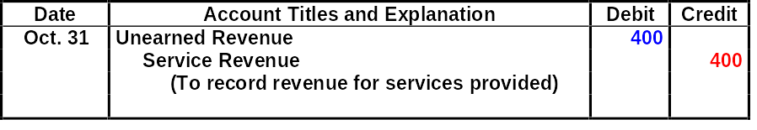
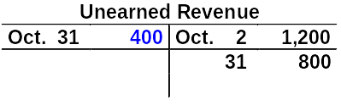

ADJUSTING ENTRIES FOR PREPAYMENTS UNEARNED REVENUES
ADJUSTMENT
October 31, analysis reveals that, of $1,200 in fees, $400 has been earned in October.
JOURNAL ENTRY
POSTING
Notes:
11

Slide 26
ACCRUALS
STUDY OBJECTIVE 6
Second category of adjusting entries is accruals
Adjusting entries
  required to record revenues earned and expenses incurred in the current period
Adjusting entry for accruals
  increase both a balance sheet and an income statement account

Slide 27
ADJUSTING ENTRIES FOR ACCRUALS
Adjusting Entries
Accrued Revenues
Asset
Revenue
Debit Adjusting Entry (+)
Credit Adjusting Entry (+)
Accrued Expenses
Expense
Liability
Debit Adjusting Entry (+)
Credit Adjusting Entry (+)

Slide 28
ACCRUED REVENUES
Accrued revenues
  accumulate with the passing of time or through services performed but not billed or collected
  An asset-revenue account relationship exists
  Prior to adjustment, assets and revenues are understated
Adjusting entry
  debit an asset account
  credit a revenue account

Slide 29
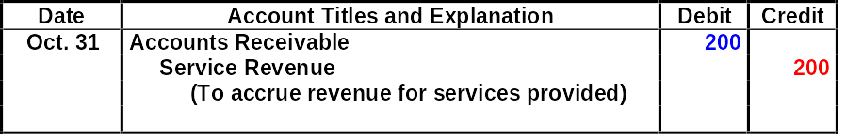

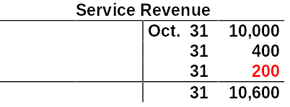
ADJUSTING ENTRIES FOR ACCRUALS ACCRUED REVENUES
ADJUSTMENT
October 31, the agency earned $200 for advertising services that were not billed to clients before October 31.
JOURNAL ENTRY
POSTING

Slide 30
ACCRUED EXPENSES
Accrued expenses
  Expenses incurred but not paid yet
  A liability-expense account relationship exists
  Prior to adjustment, liabilities and expenses are understated
Adjusting Entry
  debit an expense account
  credit a liability account

Slide 31
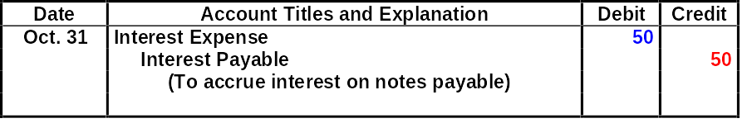


ADJUSTING ENTRIES FOR ACCRUALS ACCRUED INTEREST
ADJUSTMENT
October 31, the portion of the interest to be accrued on a 3-month note payable is calculated to be $50.
JOURNAL ENTRY
POSTING

Slide 32
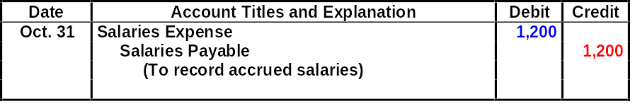


ADJUSTING ENTRIES FOR ACCRUALS ACCRUED SALARIES
ADJUSTMENT
October 31, accrued salaries are calculated to be $1,200.
JOURNAL ENTRY
POSTING

Slide 33

SUMMARY OF ADJUSTING ENTRIES
1 Prepaid Assets and Assets overstated Dr. Expenses expenses expenses Expenses understated Cr. Assets
2 Unearned Liabilities and Liabilities overstated Dr. Liabilities revenues revenues Revenues understated Cr. Revenues
3 Accrued Assets and Assets understated Dr. Assets revenues revenues Revenues understated Cr. Revenues
4 Accrued Expenses and Expenses understated Dr. Expenses expenses liabilities Liabilities understated Cr. Liabilities

Slide 34
Which of the following statements concerning accrual-basis accounting is incorrect?
a. Accrual-basis accounting follows the revenue recognition principle.
b. Accrual-basis accounting is the method required by generally accepted accounting principles.
c. Accrual-basis accounting recognizes expenses when they are paid.
d. Accrual-basis accounting follows the matching principle.

Slide 35
Which of the following statements concerning accrual-basis accounting is incorrect?
a. Accrual-basis accounting follows the revenue recognition principle.
b. Accrual-basis accounting is the method required by generally accepted accounting principles.
c. Accrual-basis accounting recognizes expenses when
they are paid.
d. Accrual-basis accounting follows the matching principle.

Slide 36
ADJUSTED TRIAL BALANCE
STUDY OBJECTIVE 7
Adjusted Trial Balance
  prepared after all adjusting entries have been journalized and posted
  purpose is to prove equality of the total debit and credit balances in the ledger after adjustments have been made
Financial statements
  prepared directly from the adjusted trial balance

Slide 37
TRIAL BALANCE AND ADJUSTED TRIAL BALANCE COMPARED
PIONEER ADVERTISING AGENCY
Adjusted Trial Balance
October 31, 2005
Before
After
Adjustment
Adjustment
Debit
Credit
Debit
Credit
Cash
$ 15,200
$ 15,200
Accounts Receivable
200
Advertising Supplies
2,500
1,000
Prepaid Insurance
600
550
Office Equipment
5,000
5,000
Accumulated Depreciation - Office Equipment
$
40
Notes Payable
$ 5,000
5,000
Accounts Payable
2,500
2,500
Interest Payable
50
Unearned Revenue
1,200
800
Salaries Payable
1,200
C. R. Byrd, Capital
10,000
10,000
C. R. Byrd, Drawing
500
500
Service Revenue
10,000
10,600
Salaries Expense
4,000
5,200
Advertising Supplies Expense
1,500
Rent Expense
900
900
Insurance Expense
50
Interest Expense
50
Depreciation Expense
40
$ 28,700
$ 28,700
$ 30,190
$ 30,190
Notes:
Lighten blue

Slide 38
PREPARING FINANCIAL STATEMENTS
  Financial statements are prepared directly from the adjusted trial balance
Income statement
use the revenue and expense accounts
Owner’s Equity Statement
use the owner’s capital and drawing accounts and the net income
(or net loss) from the Income Statement
Balance sheet
use asset and liability accounts and ending owner’s capital
balance reported in Owner’s Equity Statement

Slide 39
PREPARATION OF THE INCOME STATEMENT AND THE OWNER’S EQUITY STATEMENT FROM THE ADJUSTED TRIAL BALANCE
PIONEER ADVERTISING AGENCY
Adjusted Trial Balance
October 31, 2005
Debit
Credit
Cash
$ 15,200
Accounts Receivable
200
Advertising Supplies
1,000
Prepaid Insurance
550
Office Equipment
5,000
Accumulated Depreciation - Office Equipment
$ 40
Notes Payable
5,000
Accounts Payable
2,500
Interest Payable
50
Unearned Revenue
800
Salaries Payable
1,200
C. R. Byrd, Capital
10,000
C. R. Byrd, Drawing
500
Service Revenue
10,600
Salaries Expense
5,200
Advertising Supplies Expense
1,500
Rent Expense
900
Insurance Expense
50
Interest Expense
50
Depreciation Expense
40
$ 30,190
$ 30,190

Slide 40
PREPARATION OF THE INCOME STATEMENT AND THE OWNER’S EQUITY STATEMENT FROM THE ADJUSTED TRIAL BALANCE
PIONEER ADVERTISING AGENCY
Income Statement
For the Month Ended October 31, 2005
Revenues
Fees earned
$ 10,600
Expenses
Salaries expense
$ 5,200
Advertising supplies expense
1,500
Rent expense
900
Insurance expense
50
Interest expense
50
Depreciation expense
40
Total expenses
7,740
Net income
$ 2,860
The income statement is prepared from the revenue and expense accounts.

Slide 41
PREPARATION OF THE INCOME STATEMENT AND THE OWNER’S EQUITY STATEMENT FROM THE ADJUSTED TRIAL BALANCE
PIONEER ADVERTISING AGENCY
Adjusted Trial Balance
October 31, 2005
Debit
Credit
Cash
$ 15,200
Accounts Receivable
200
Advertising Supplies
1,000
Prepaid Insurance
550
Office Equipment
5,000
Accumulated Depreciation – Office Equipment
$ 40
Notes Payable
5,000
Accounts Payable
2,500
Interest Payable
50
Unearned Revenue
800
Salaries Payable
1,200
C. R. Byrd, Capital
10,000
C. R. Byrd, Drawing
500
Service Revenue
10,600
Salaries Expense
5,200
Advertising Supplies Expense
1,500
Rent Expense
900
Insurance Expense
50
Interest Expense
50
Depreciation Expense
40
$ 30,190
$ 30,190
Notes:
Unbright

Slide 42
PREPARATION OF THE INCOME STATEMENT AND THE OWNER’S EQUITY STATEMENT FROM THE ADJUSTED TRIAL BALANCE
PIONEER ADVERTISING AGENCY
Owner’s Equity Statement
For the Month Ended October 31, 2005
C.R. Byrd, Capital, October 1
$
-
0
-
Add: Investments
$ 10,000
Net income
2,860
12,860
12,860
Less: Drawings
500
C.R . Byrd, Capital, October 31
$ 12,360
The owner’s equity statement is prepared from the owner’s capital and drawing accounts and the net income (or net loss) shown in the income statement.

Slide 43
PREPARATION OF THE BALANCE SHEET FROM THE ADJUSTED TRIAL BALANCE
PIONEER ADVERTISING AGENCY
Adjusted Trial Balance
October 31, 2005
Debit
Credit
Cash
$ 15,200
Accounts Receivable
200
Advertising Supplies
1,000
Prepaid Insurance
550
Office Equipment
5,000
Accumulated Depreciation – Office Equipment
$ 40
Notes Payable
5,000
Accounts Payable
2,500
Interest Payable
50
Unearned Revenue
800
Salaries Payable
1,200
C. R. Byrd, Capital
10,000
C. R. Byrd, Drawing
500
Service Revenue
10,600
Salaries Expense
5,200
Advertising Supplies Expense
1,500
Rent Expense
900
Insurance Expense
50
Interest Expense
50
Depreciation Expense
40
$ 30,190
$ 30,190

Slide 44
PREPARATION OF THE BALANCE SHEET FROM THE ADJUSTED TRIAL BALANCE
PIONEER ADVERTISING AGENCY
Balance Sheet
October 31, 2005
Assets
Liabilities and Owner’s Equity
Cash
$ 15,200
Liabilities
Accounts receivable
200
Notes payable
$ 5,000
Advertising supplies
1,000
Accounts payable
2,500
Prepaid insurance
550
Interest payable
50
Office equipment
$ 5,000
Unearned fees
800
Less: Accumulated
Salaries payable
1,200
depreciation
40
4,960
Total liabilities
9,550
Owner’s equity
C.R. Byrd, Capital
12,360
Total liabilities and owner’s
Total assets
$ 21,910
equity
$ 21,910
The balance sheet is then prepared from the asset and liability accounts and the ending owner’s capital balance as reported in the owner’s equity statement.

Slide 45
ALTERNATIVE TREATMENT
OF PREPAID EXPENSES AND UNEARNED REVENUES
Alternative treatment uses Income Statement accounts initially
  Debit the expense for prepaid expenses when cash is paid
  Credit the revenue at the time cash is received
After adjustments, alternative treatment of prepaid expenses and unearned revenues will result in the same effect to financial statements as the initial entries to the balance sheet accounts
STUDY OBJECTIVE 8

Slide 46
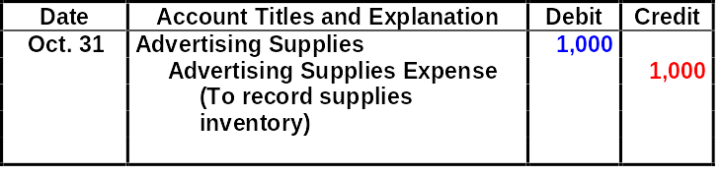


ALTERNATIVE ADJUSTMENTS FOR PREPAYMENTS SUPPLIES
ADJUSTMENT
October 31, an inventory count reveals that $1,000 of $2,500 of supplies are still on hand.
JOURNAL ENTRY
POSTING

Slide 47
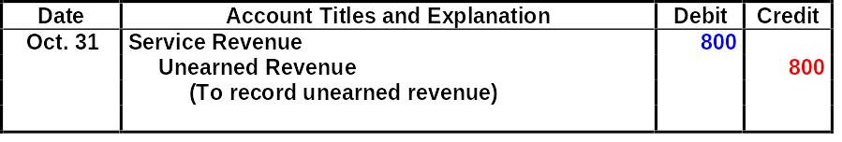


ALTERNATIVE ADJUSTMENTS FOR PREPAYMENTS UNEARNED REVENUES
ADJUSTMENT
October 31, analysis reveals that, of $1,200 in fees, $400 has been earned in October.
JOURNAL ENTRY
POSTING

Slide 48
SUMMARY OF BASIC RELATIONSHIPS FOR PREPAYMENTS
1 Prepaid Assets and a Prepaid expenses Assets overstated Dr Expenses Expenses Expenses initially recorded in Expenses understated Cr Assets asset accounts have been used.
b Prepaid expenses Assets understated Dr Assets initially recorded in Expenses overstated Cr Expenses expense accounts have not been used.
2 Unearned Liabilities and a Unearned revenues Liabilities overstated Dr Liabilities Revenues Revenues initially recorded in Revenues understated Cr Revenues liability accounts have been earned.
b Unearned revenues Liabilities understated Dr Revenues initially recorded in Revenues overstated Cr Liabilities revenue accounts have not been earned.
Notes:
Fix ME

Slide 49
Which of the statements below is not true?
1. An adjusted trial balance should show ledger account balances.
2. An adjusted trial balance can be used to prepare financial statements.
3. An adjusted trial balance proves the mathematical equality of debits and credits in the ledger.
4. An adjusted trial balance is prepared before all transactions have been posted from the journal.

Slide 50
Which of the statements below is not true?
1. An adjusted trial balance should show ledger account balances.
2. An adjusted trial balance can be used to prepare financial statements.
3. An adjusted trial balance proves the mathematical equality of debits and credits in the ledger.
4. An adjusted trial balance is prepared before all transactions have been posted from the journal.

Slide 51

COPYRIGHT
Copyright © 2005 John Wiley & Sons, Inc. All rights reserved. Reproduction or translation of this work beyond that permitted in Section 117 of the 1976 United States Copyright Act without the express written consent of the copyright owner is unlawful. Request for further information should be addressed to the Permissions Department, John Wiley & Sons, Inc. The purchaser may make back-up copies for his/her own use only and not for distribution or resale. The Publisher assumes no responsibility for errors, omissions, or damages, caused by the use of these programs or from the use of the information contained herein.

